Slide 1

TECHNICAL PRESENTATION
CSA0309
Data Structures
Presented by:
Guru Charan M
Reg. No.: 192524434
Date: 09/10/2026

Slide 2


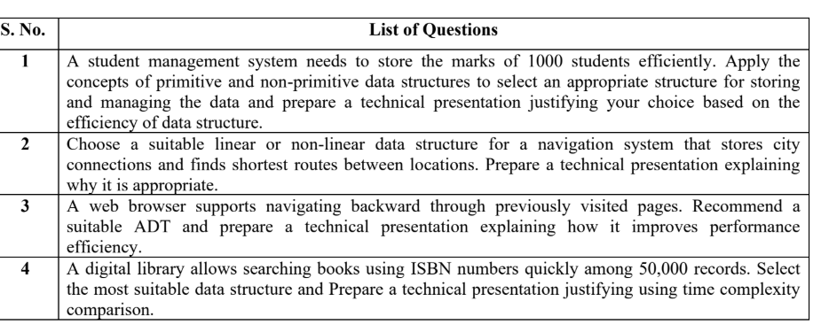
Questions
2

Slide 3
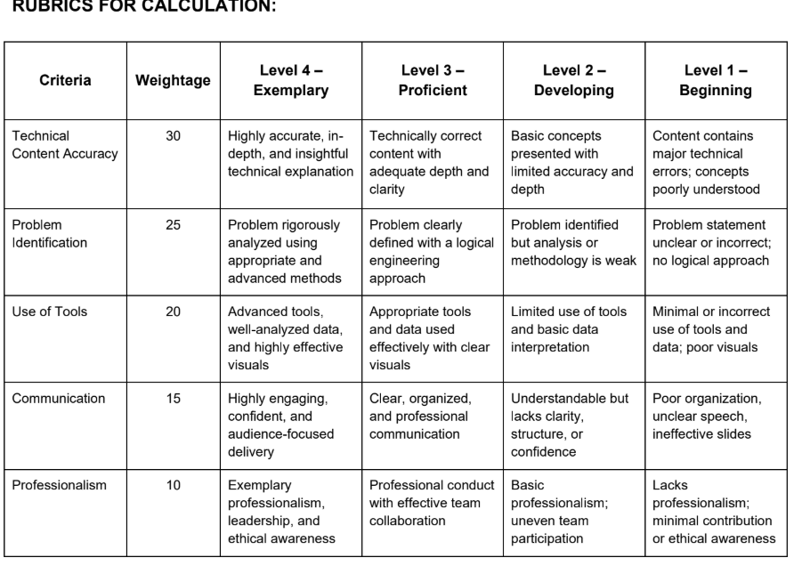
Rubrics
2

Slide 4
Introduction
• Overview: select data structures for four real-world computing tasks.
• Problem statement: each task needs efficient storage, navigation, history management, or search.
• Purpose: justify each selection using operations, time complexity, and space complexity.
• Topics: student marks, city routes, browser history, and ISBN search.
2

Slide 5

Question 1: Student Marks Management
• Requirement: store and manage marks for 1,000 students.
• Primitive data: int for student IDs and float/double for marks.
• Non-primitive structure: an array of Student records ,groups ID, name, and marks.
• Recommendation: use an array of records when the number of students is known and indexed access is useful.
3

Slide 6

Question 1: Efficiency Justification
• Access or update by known index: O(1).
• Calculate class average or find a mark by scanning: O(n), where n = 1,000.
• Limitation: insertion or deletion in the middle may take O(n) because elements shift.
• Conclusion: an array of records is a simple, memory-efficient choice for a fixed-size class list.
4

Slide 7

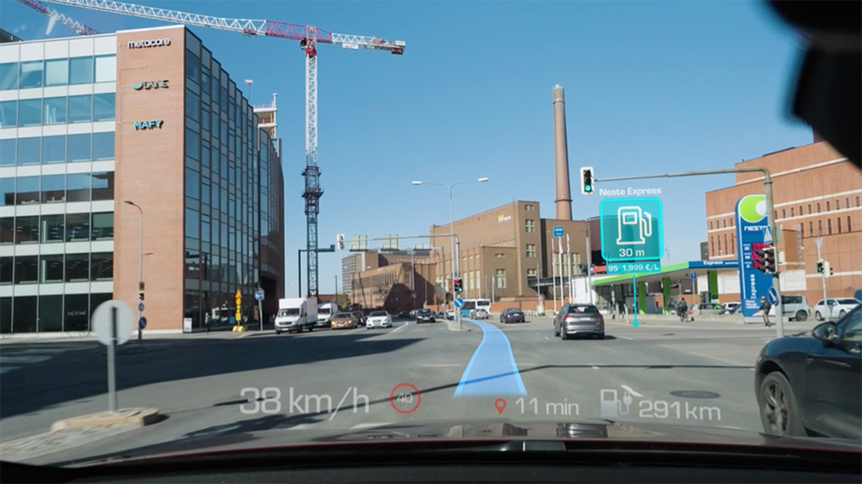
Question 2: City Navigation System
• Model each city as a vertex and each road as an edge.
• Store distance or travel time as a weight on each edge.
• Recommendation: a weighted graph represented by an adjacency list.
5

Slide 8
Question 2: Efficiency Justification
• Adjacency-list space complexity: O(V + E), where V is cities and E is road connections.
• An adjacency list is space-efficient for sparse networks where each city connects to only some cities.
• BFS is suitable only when every edge has equal cost; negative edge weights require another algorithm such as Bellman–Ford.
6

Slide 9
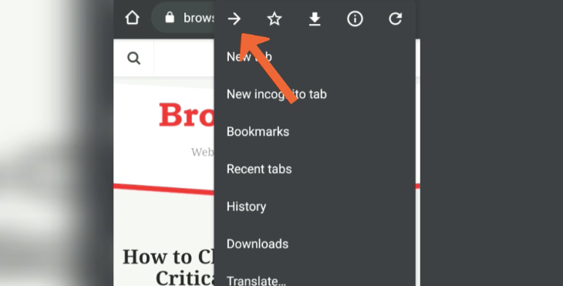
Question 3: Browser Back Navigation
• Requirement: return to the most recently visited page when the user selects Back.
• Recommendation: Stack ADT, which follows LIFO (Last In, First Out).
• When visiting a page, push the current page onto the history stack.
• When Back is selected, pop the most recent page and return to it.
7

Slide 10
Question 3: Efficiency Justification
• Push, pop, and peek are O(1) operations in a typical stack implementation.
• Back navigation does not need to scan the full history list to find the previous page.
• Space complexity: O(h), where h is the number of stored history entries.
• Conclusion: Stack ADT matches the required LIFO behavior and provides efficient navigation.
8

Slide 11

Question 4: Digital Library ISBN Search
• Requirement: search a book quickly by ISBN among 50,000 records.
• Recommendation: a hash table with ISBN as the key.
• A hash function maps each ISBN to a table index, where the book record can be found.
• Use collision handling such as chaining or open addressing.
9

Slide 12
Question 4: Time Complexity Comparison
• Unsorted array/list: O(n) search; up to 50,000 records may be checked.
• Balanced search tree: O(log n) search; approximately log₂(50,000) ≈ 16 comparisons.
• Hash table: expected O(1) lookup with a good hash function and controlled collisions.
• Conclusion: hashing is the best fit for frequent exact-match ISBN lookups.
10

Slide 13
Thank You!

